Slide 1

Attacks Using Steganography (images)
Presented by: Suba Sah

Slide 2
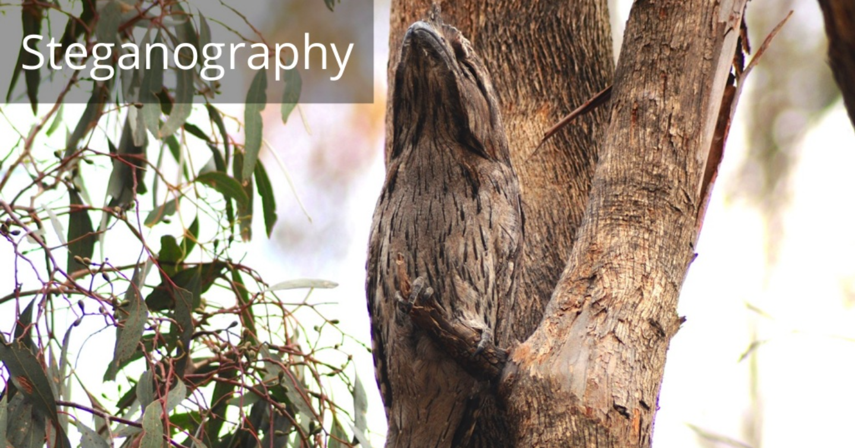

Slide 3
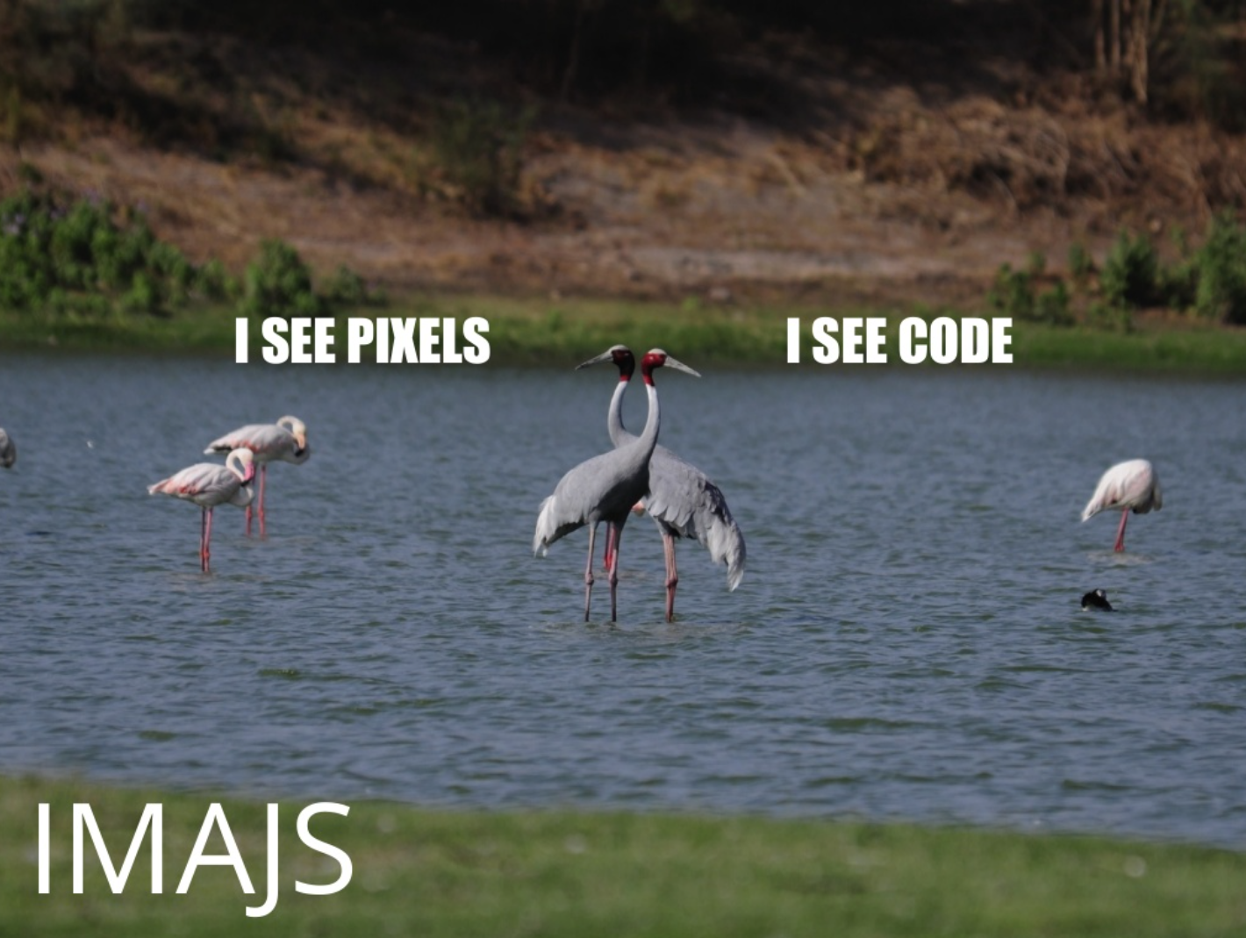

Slide 4
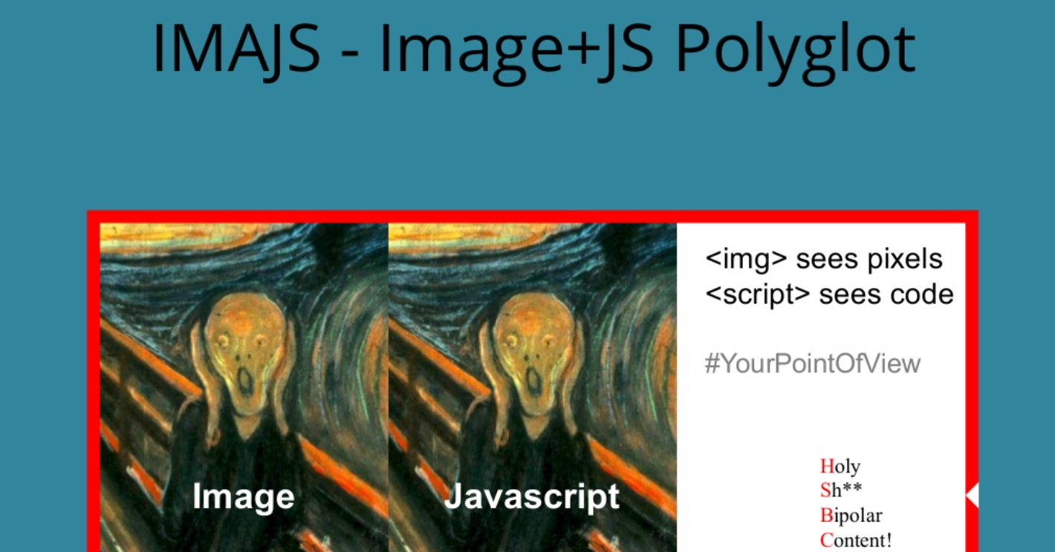

Slide 5
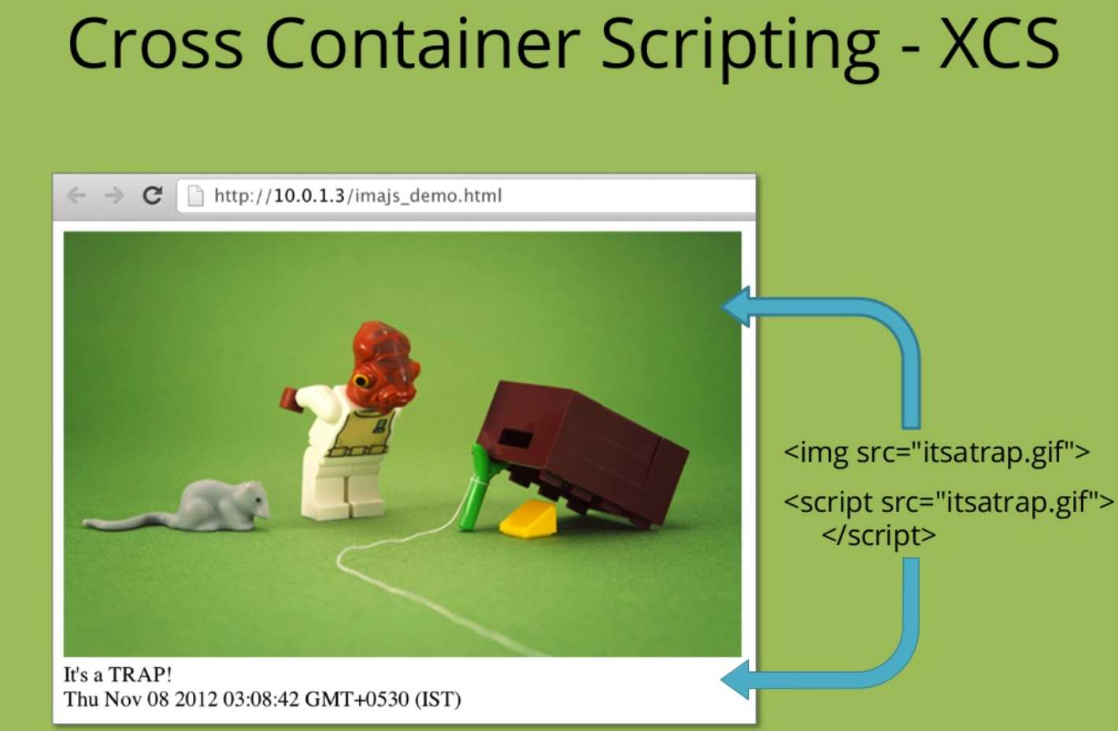

Slide 6
IMAJS – The Concept
Polyglot “files”
- term coined by Ange Albertini
IMAJS is targeted towards browsers.
It is a perfectly valid image …
…and a perfectly valid JavaScript!
Hence, it poses threat to us!

Slide 7
Hacking with Pictures
Network traffic – ONLY image files
We bypass the Content Security Policy(CSP)
Prevents executing inline JavaScript, but
Serving JS files from the same domain

Slide 8
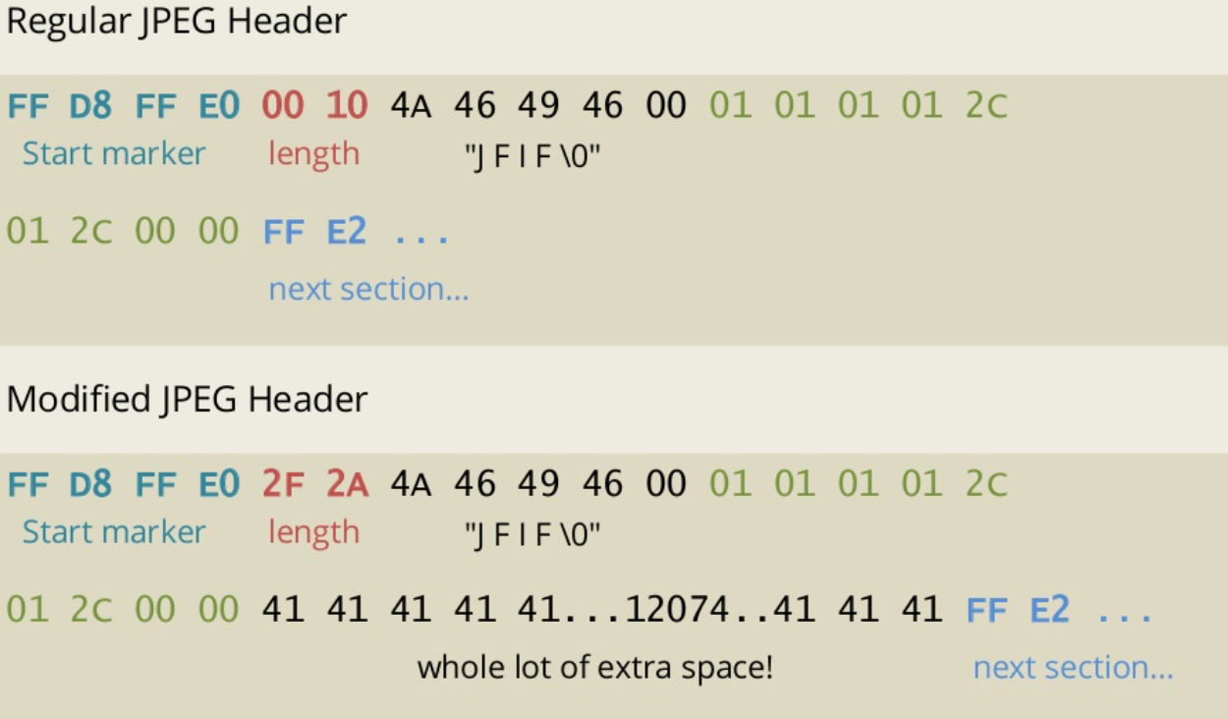
The Secret Sauce

Slide 9
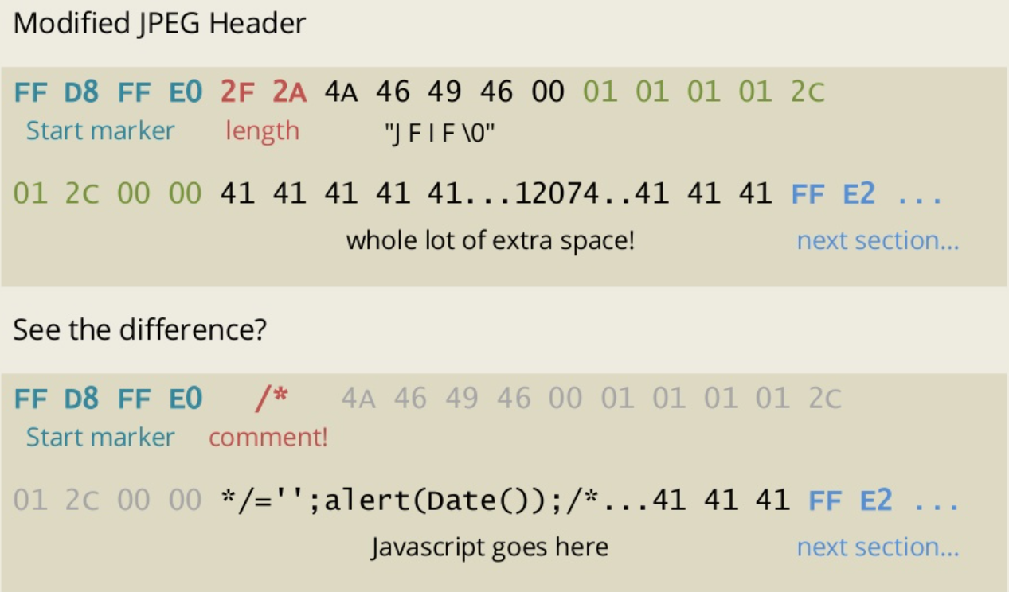
The Secret Sauce

Slide 10
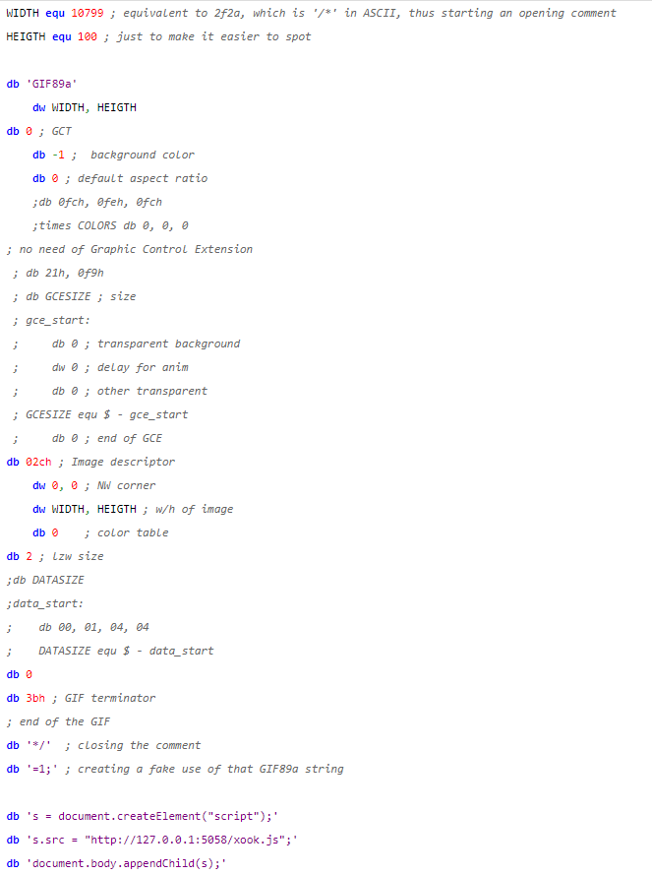
Gif File Format

Slide 11
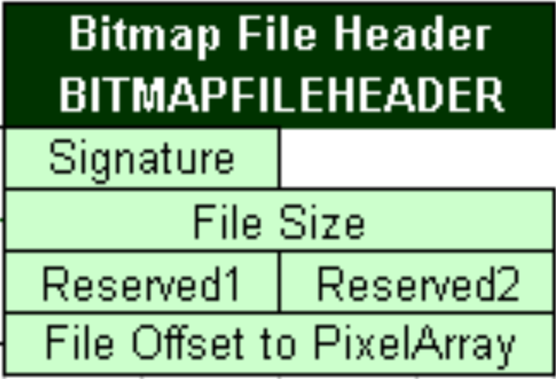
BMP File Format

Slide 12

Demo Time

